Slide 1
Oracle ADF Best Practices

Slide 2
Single application workspace comprising of multiple projects – monolithic approach
In this model the entire application uses a single JDeveloper workspace, which may contain one or more model and view controller projects based on the complexity of the application:
Single view controller and model project : suitable for small applications . The major disadvantage is the poor reusability of modules
Single view controller and multiple model projects: for small to medium sized business applications where the numbers of UI pages are minimal (below 50 pages)
Multiple view controller and model projects : One of the view controller projects will be logically designated as the master view controller. This structure will fit for small to medium sized applications (above 50 pages)

Slide 3
Multiple application workspaces controlled by a single master application– microkernel approach
an enterprise may want to bundle services exposed by multiple applications into a new product and release it in line with their existing product portfolio. you must have a single master application workspace which controls the final application artefact.
Improves modularity of the system
Maintenance becomes easier
Rapid development time, new modules can be tested independently
Improves reusability of the modules
Challenges:
dependency management mechanisms provided by the JDeveloper IDE may not work.
Each workspace needs to be managed independently and version controlled.

Slide 4
Guidelines for setting up the application source using the microkernel approach
Make sure you create one workspace for each deployable Enterprise Archive (EAR) file.
Business functionality should be the major driving factor in deciding the projects, second comes the technology specific constrains
Projects are also organized by how they want to share that code with others.
Each project creates a single Java Archive (JAR) file (ADF Library)
Make sure all "public projects" generate JARs to a public location

Slide 5
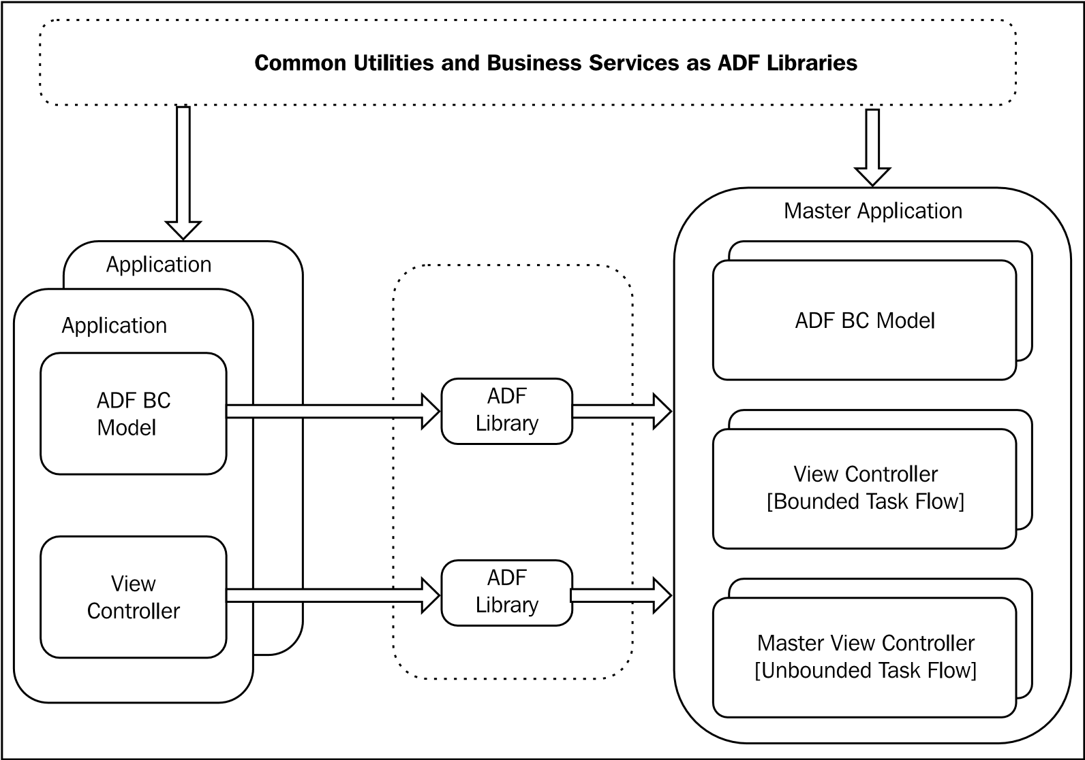
Guidelines for setting up the application source using the microkernel approach

Slide 6
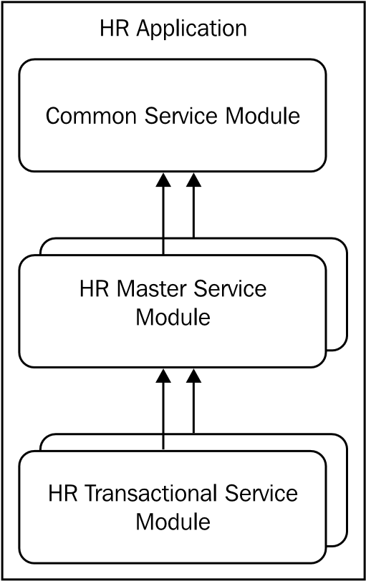
How to avoid cyclic dependency between modules
Identify the common services and utilities for the application and move them to a common project
Identify logically independent business modules for the application and build the model project for them
Identify a more granular level of business modules and build model projects for them

Slide 7
Life span of an application module
By default, the framework eagerly loads all the components added to an application module, such as view object instances and nested application modules, when it is instantiated. You can specify the jbo.load.components.lazily parameter to JVM to control this behavior as java –D jbo.load.components.lazily = true or false
then child components such as view objects or nested application modules are instantiated and added to the application module only when the client refers to them by calling through .
findViewObject
findApplicationModule

Slide 8
How the framework allocates an application module for serving a client request
The initial application module pool size is determined by the initial pool size parameter (jbo.ampool.initpoolsize) (zero is default)
To reduce the delay in instantiating application modules, it is recommended to keep this value at 10 percent (buffer size) more than the expected number of concurrent application module instances required to service the concurrent users

Slide 9
How the framework allocates an application module for serving a client request
When a client request tries to grab an application module instance and if there are no un-referenced instances available in the pool:
The framework will check to see whether the application module used for serving the last request from the current requestor is available if found, then allocate it
If not : the framework creates a new instance:
creates a new application module instance if the number of application module instances in the pool is less than the recycle threshold value (jbo.recyclethreshold).
creates a new application module instance if all the instances in the pool are in use, and the current pool size is less than the maximum pool size (jbo.ampool.maxpoolsize)

Slide 10
How the framework allocates an application module for serving a client request
If the number of application module instances in the pool has reached the recycle threshold value then the framework will look for LRU instance in the pool and will allocate it. (passivation and activation is done here).
If all instances in the pool are currently in use and the number of instances in the pool has reached the maximum pool size, then the framework will notify of the development by throwing an exception to the caller

Slide 11
More configuration options for an application module
jbo.recyclethreshold : decides the maximum number of application module instances in the pool that are released in the managed state mode by the previous clients .(Default 10)
jbo.doconnectionpooling (Disconnect Application Module upon Release) : This setting forces the application module to release the JDBC connection back to the connection pool each time it is checked-in back to the pool at end of the request.
jbo.txn.disconnect_level : The default value is 0. You can set this property 1 to bypass the database centric passivation cycle of business components , All remain in memory but their corresponding references to JDBC objects, such as open cursors, are closed and cleaned up

Slide 12
More configuration options for an application module
jbo.maxpassivationstacksize: controls the number of snapshots that the business component framework manages for performing the undo (rollback) operation
When you explicitly call passivateStateForUndo
When the task flow acquires save points on entry

Slide 13
When an application module is removed from the pool
The framework deploys an application module pool monitor on each Java Virtual Machine (JVM) to clean up the unused instances.
time interval of every 600000 milliseconds (10 min) by default. Can be overridden by jbo.ampool.monitorsleepinterval .
When the pool monitor performs the cleanup, it will try to bring down the number of instances in the pool to the maximum available size configured using the jbo.ampool.maxavailablesize parameter. (Default 25)
If you do not want the pool monitor to clean up the entire pool when all the instances are eligible for removal, you can specify the minimum available size for the pool using jbo.ampool.minavailablesize. (Default 5)

Slide 14
When an application module is removed from the pool
The application module pool monitor will remove all the unused application module instances which have been living in the pool for more than 3600000 milliseconds (one hour) without bothering about the minimum available size. override maximum time jbo.ampool.timetolive. (default value is one hour). To ignore this property at runtime, you can set the value to -1.
The application module pool monitor will remove all the application module instances that are idle for 600000 milliseconds (10 minutes). This cleanup will be stopped when the number of instances in the pool reaches the minimum available size . override jbo.ampool.maxinactiveage (default 10 min)
If you do not want your application module to be removed from the pool, you can set jbo.ampool.timetolive and jbo.ampool.maxinactiveage to -1

Slide 15
Configuring the application module pool parameters
Tips :
Keep jbo.ampool.maxavailablesize 20 percent higher than normal use.
Keep jbo.ampool.minavailablesize the same as jbo.ampool.maxavailablesize. This ensures that application module pool is always prepared to meet a high load.

Slide 16
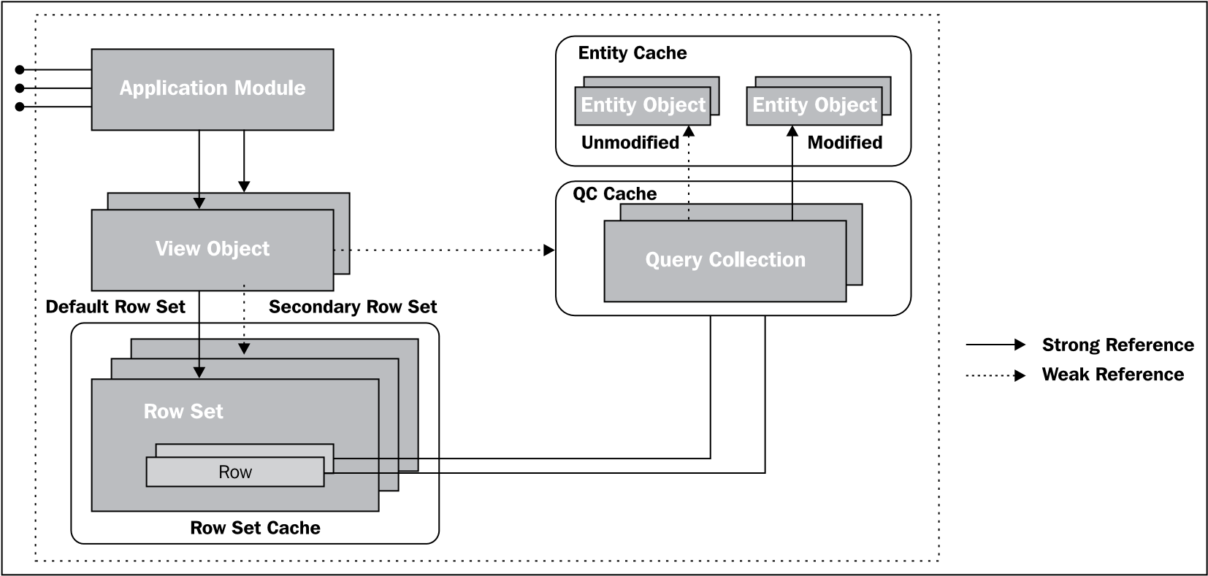
Life span of a view object, row set, and query collection in a regular application module
The lifecycle of a view object starts when a client calls executeQuery() on a view object instance in order to retrieve the data collection from the underlying data source.

Slide 17
Life span of a view object, row set, and query collection in a regular application module
All query collections and all the secondary row sets belonging to a view object in a regular application module are cached as weak references.
The parent view object gives special treatment to the default row set. The default row set resulted from the query execution is strongly referenced by the parent view object

Slide 18
The query collection cache and view accessor row set
The framework will return the row set from the cache if it is found for the current row filter
If you do not want the framework to read from the cache:
protected ViewRowSetImpl createViewLinkAccessorRS(AssociationDefImpl assocDef, ViewObjectImpl accessorVO, Row masterRow, Object[] values){
if ("<viewlink accessor attribute name>".equals(assocDef.getName()))
{
accessorVO.clearCache(); }
return super.createViewLinkAccessorRS
(assocDef, accessorVO, masterRow, values);
}

Slide 19
The life span of entity objects
Entity object cache implementation stores unmodified rows in a weakly referenced hash map (java.util.WeakHashMap)
All weakly referred entity rows in the cache will be cleaned up in memory pressure, leaving dirty (new, modified, and deleted) rows intact

Slide 20
Clear an entity cache at specific points in time
Configuring an application module to clear the cache during transaction rollback or commit
<AppModule ClearCacheOnCommit=“true“ … />
You can set this property at runtime by calling setClearCacheOnCommit(true) on the oracle.jbo.Transaction
Programmatically clearing cache
this.getDBTransaction().clearEntityCache(fullEOName);
This method will throw oracle.jbo.InvalidOperException if you are trying to clear an entity object cache with pending changes

Slide 21
The life span of row sets in a shared application module
All the query collections in shared application modules are strongly referenced. The shared query collection pool monitor polls the shared query collection pool at an interval of 1800000 milliseconds (30 minutes) .
Override jbo.qcpool.monitorsleepinterval property
The default idle timeout is 900000 milliseconds (15 minutes).
override jbo.qcpool.maxinactiveage property
The pool monitor will check to see if the total weight of the pool exceeds the maximum weight.
the pool monitor will start removing the least recently used (LRU) query collections until the weight falls below the limit
override jbo.qcpool.maxweight (by default no limit)

Slide 22
The life span of binding objects
The binding context is cached in the HTTP session object for use in subsequent requests from the same user
The framework will remove all the cached binding containers when the user navigates away to a new data bound page with a page definition file behind it.
The binding context is removed from the session cache on session timeout, session invalidation, or on session failover

Slide 23
Tips for optimizing an application module initialization
Enable lazy loading for application module contents, such as view object instances and nested application module instances.
Lazy Loading
Non-Lazy Loading
Runtime Instantiation (default set by java property : Djbo.load.components.lazily = true or false)
Sometimes you may need to explicitly create application module instances by calling createRootApplicationModule
You should call releaseRootApplicationModule(ApplicationModu le appModule, boolean remove) to release it. Make sure you are passing false to the remove

Slide 24
Tips for optimizing resource usages in an application module
If the web page or business logic implementation demands data from multiple application modules, then you can build composite services by nesting the desired application modules under a root application module.
All nested application modules share the same database connection and transaction context. Note that a nested application module cannot have different database connections
When you call commit () or rollback () on a transaction object associated with a root application module, the framework invokes commits or rollbacks on all the nested application modules as well
When you use the shared application modules for accessing read only data, you do not really need to have a separate transaction context for each usage. override jbo.shared.txn by a same name in shared modules.
For better performance, enable connection pooling and in-memory passivation jbo.doconnectionpooling = true , jbo.txn.disconnect_level=1

Slide 25
Tips for fine-tuning the JDBC API use
If you want to limit the caching of JDBC cursors used in a session, override jbo.max.cursors to a lower value in the application module configuration. (default value 50)
Use JDBC data source over JDBC Connection URL
If you have multiple application modules connecting to the same database, make sure the same JDBC data source name is used in all application modules

Slide 26
Coding guidelines for application modules
Do not call postChanges() on DBTransaction in an application module if you are not going to commit the transaction within the same request. Also avoid using the global temporary table or PLSQL global variable to hold the result across requests
Avoid defining member variables in an application module and view object classes because of activation , passivation skipping. If you have variables stored in a UserData hash table session, you must make sure that they are activation safe.
At the end of a request, the framework releases the application module instance used for serving the requestBy default, the application module is released in the managed (stateful) mode . You can override this behavior by explicitly invoking resetState() on DCDataControl at the end of the request For example for logout.

Slide 27
Coding guidelines for application modules
If you want to use JDBC APIs such as java.sql.Statement, java.sql. PreparedStatement, or java.sql.CallableStatement use DBTransaction to obtain them.
Use the native Java types instead of jbo data types whenever possible. This is especially useful when you need to expose the business service for public use

Slide 28
Tips for optimizing query execution in a view object
If the query executed by a view object is expected to have a WHERE clause all the time, add the WHERE clause directly to the query at design time
Use the named bind parameters over indexed bind parameters wherever possible. This makes your code more readable
Avoid using SELECT * FROM <TABLE_NAME> in a query for a view object
Use declarative query mode whenever possible
Build view objects are backed up by entity objects whenever possible , While building a read only view object, backed up by entity objects, make sure you are choosing non-updatable entity objects
Out of the box support for managing newly created rows across view objects
View row instances backed up by entity objects are updatable and they participate in the transaction post cycle
Multiple view objects backed up by the same entity objects will be referring to the same data storage

Slide 29
Tips for optimizing database read operations
If you want to use a view object for creating rows alone, select the option No Rows under the Tuning section in the General tab of the view object editor. If the same view object is used in both create and query mode then you should call setMaxFetchSize(0) on the view object instance.
To configure the fetch size, open the view object in the editor and set the appropriate value for the in Batches of field in the General | Tuning section. If the view objects are used in the UI, the fetch size must be the range size of the iterator in the page definition file +1 , Range Pagination +3
JDBC implementation pre-allocates memory to hold the returned result set based on the fetch size. You should not set a very high value for the fetch size. For view objects used in the UI, the fetch size should be ideally less than 30.

Slide 30
Tips for optimizing database read operations
You can override the fetch size at the view object instance level when exposed through an application module, and at view accessor level when used in another view object
When you need to display a large number of rows in the read-only mode, specify the Access Mode for the underlying view object as Range Paging or Range Paging Incremental. This mode keeps only the current range of rows in memory.
For Range Paging Incremental, the page size in the query is equal to the range size multiplied by the cache factor
The framework will not generate a paginated query if the view object uses other access modes such as Scrollable or Forward Only

Slide 31
Tips for setting a global row fetch limit for view objects
You can globally specify the row fetch limit for all view objects used in an application by configuring the row fetch limit in adf-config.xml . When a client tries to access rows beyond the row fetch limit, the framework will log an oracle.jbo.RowLimitExceededWarning message.
Specify the maximum fetch size on a view object to a large value
You can specify this programmatically via the setMaxFetchSize() call on the view object instance, or declaratively via the Only up to row number setting
Override getRowLimit() in ViewOblectImpl to return -1
Set the access mode of the view object as Forward Only (FORWARD_ONLY). Forward Only view objects are not subjected to a row limit as they do not cache any row set

Slide 32
Tuning view criteria in view objects
Define the appropriate view criteria in a view object if you need to conditionally append the WHERE clause to the query
While using a search panel backed up by view criteria, if an empty search results in thousands of rows, mark at least one view criteria item as Required or Selectively Required . To improve the query performance in a database, you can index the columns that form a view criteria item
To force the runtime to generate temporary bind variables instead of directly using literal values while generating the WHERE clause for the view criteria, set useBindVarsForViewCriteriaLiterals as true in adf-config.xml

Slide 33
Tips for optimizing LOV definitions
Use smart LOV definitions whenever possible. You can define a smart LOV by choosing the Filter Combo Box option in the LOV editor
Avoid choosing the Query List Automatically feature for the LOVs with search pop ups
The number of rows returned by an LOV data source view object is decided by the ListRangeSize value set in the list binding definition in the view object XML file ,for Input Text with List of Values and Combo Box with it should be equal to the number of rows to be displayed on the LOV +1 and for the others -1.

Slide 34
Tips for optimizing LOV definitions
By default, IDE sets RowLevelBinds as true in the view accessor definition. This settings means that the values for the LOV may change for each row . set this flag to false if the set of LOV values is the same for every row
Do not specify unwanted dependency attributes on an LOV enabled attribute.
Choose the LOV types judiciously. Use Input Text with List of Values or Combo Box with List of Values if the LOV displays more than 25 elements.

Slide 35
General tips for tuning view objects
When a view object is used only in validation or in business logic to query the data source and not to be displayed in the UI, define it as a read-only view object with the access mode set as Forward Only to avoid the caching of rows in the middle tier
Avoid using view link instances if you do not need them.
To enable the caching of child row sets, select the Retain View Link Accessor option for the child view object
If a view object contains transient attributes whose value can be derived from other persisted attributes, you must turn off passivation for those attributes

Slide 36
Coding guidelines for view objects
When you need to define a view object at runtime, consider using (if feasible) APIs for creating oracle.jbo.server.ViewDef over the method createViewObjectFromQueryStmt(String voName, String sqlStatement) in oracle.jbo.server.ApplicationModuleImpl
While accessing attribute values of a view object row or entity row, use the getAttribute(int index) API which takes the attribute index as a parameter over the getAttribute(String name)
Create a secondary RowSetIterator if you need to iterate over rows of view objects in your business logic
When you want to execute a query with different bind variable values without affecting the default row set used in the UI, you must create a secondary row set and execute the same.

Slide 37
Coding guidelines for view objects
Do not add attributes to a view object after executing it. You cannot add dynamic attributes to a view object once it is executed.
If you need to populate transient attribute values based on complex business logic or using data from a third party data source and you want to avoid re-execution of this initialization logic for each access to the attribute, then you can override createRowFromResultSet(Object qc,ResultSet resultSet) and rowImpl.populateAttribute .
Prevent the caching of row sets in the access mode of the view object to Forward Only. If you want to conditionally set the access mode at runtime, call setForwardOnly(true) on the view object. You can restore the original access mode later based on the use case

Slide 38
Coding guidelines for view objects
When you modify the WHERE clause fragment of the view object by calling setWhereClause() on a view object, make sure that you use bind variable for supplying the parameter values
Count queries make sense when the client really needs the total number of recodes
When you call getEstimatedRowCount(), getCappedQueryHitCount(), or getCappedRowCount(cap) on a view object, the framework fires a count query on the underlying database tables
When you call getRowCount() on a view object, the framework will fetch all the rows from the underlying table that matches the search criteria and iterates the rows to find the total number

Slide 39
Coding guidelines for view objects
Don't use Count queries just to find out whether a query retuned any rows.
Row r = employeeVO.first();
if (r != null)
Avoid using SQL conversion functions such as to_date(), to_number(), and to_char() in the query. You must do this in the middle tier Java class instead
You can use Groovy expressions to initialize bind variables used in a view criteria as well as in the SQL WHERE clause with runtime values . use the Groovy expression now() for the current date and time, and today() for the current date.

Slide 40
Tips for validating entity objects
If you build an entity object based on a database view or synonyms, make sure that the framework is able to read all the required records to perform out of the box functionalities enabled on it.
Use the appropriate attribute level validation to validate individual attribute values. To perform validation across attributes in a row use entity level validation. Avoid adding validation to attribute setter methods or to any other entity object lifecycle method.
To create custom validation that needs to be triggered once for the entire entity collection before committing the transaction, define a method validation in the entity object and in select Defer the execution to Transaction Level and keep SkipValidation="skipDataControls" in the page definition file.

Slide 41
General tips for tuning entity objects
Always define primary keys for an entity object. You should not use RowId as a primary key for an entity object in a real-life application because it is not guaranteed to be unique when the database runs in a clustered environment
You need not set the foreign key values for a child entity object in a composite association; this is taken care of by the framework.
Retain the association accessor row set in an entity object as appropriate.
If your table has a column to hold the version for the row, mark it as Change Indicator

Slide 42
General tips for tuning entity objects
When you override Where or Reverse Where clauses in association, the framework, by default, will turn off association consistency for the target If you want the row set to see the un-posted rows, you need to call setAssociationConsistent(true)
Do not select transient attributes when you define associations between entity objects. You must use SQL derived attributes in such cases.

Slide 43
Coding guidelines for entity objects
If you use a surrogate primary key for an entity object, initialize it by either using a Java unique ID generator or using the database sequence , Using these techniques makes sure that the surrogate primary key attribute is initialized during the instance creation itself
If you have many entity rows participating in a transaction, use the Update Batching option . Note that in the following scenarios, the framework will not support batch update:
If the entity object contains one or more CLOB or BLOB attribute
If one or more attributes are marked as either Refresh on Insert or Refresh on Update
If you have overridden the doDML() method of the entity object to use custom logic or PLSQL procedure for posting changes to the data source

Slide 44
Coding guidelines for entity objects
Override the create() method in the entity object implementation to change the status of the entity object when attributes are defaulted
Never import any client side classes or binding classes in your business service implementation code
To read the current database time in the middle tier, call the oracle. jbo.server.DBTransactionImpl.getCurrentDbTime() method (groovy DBTransaction.currentDbTime)

Slide 45
Tips for tuning executable bindings
Do not use Refresh = "always" for the executable iterator binding. This may result in refreshing the corresponding iterator multiple times during a page lifecycle
You should not use the <invokeAction> executable to execute initialization logic during the page load. This is because the <invokeAction> executable will be invoked multiple times during the page lifecycle
If your page uses the <methodIterator> executable to populate the UI table component, make sure that the corresponding <methodAction> binding definition has CacheReturnDefinition = “true”
You should not leave any unused executables or binding entry in a page definition file. Note that, by default, executables such as <invokeAction> and <taskFlow> will get executed even if they are not referenced in a UI.
The EL expression when used in a page definition should always start with ${} or #{}. The framework will not bother to evaluate the EL expression which comes in the middle of literal values

Slide 46
Tips for optimizing data traffic between a binding layer and business components
the RangeSize property must be set appropriately so that only the required rows are fetched to the middle tier
The RangeSize setting for the iterator binding will override the view object's range size at runtime if the value is greater than 0.
You should set RangeSize = "-1" for executable iterators bound to nonpaginated list components .
If there are multiple UI components bound to the same iterator binding definition, the range size should be set as the maximum of all rows to be read for the components.

Slide 47
Tips for optimizing data traffic between a binding layer and business components
The FetchSize property set for a view object instance in an application module should be the maximum range size configured for all iterators bound to the view object instance
The FetchSize property set for a view accessor used as data source for model-driven UI components such as LOV should not be lower than the number of rows displayed in the UI + 1. Keeping this value as 16 looks like works for most of the applications in general.
When you use the <af:table> component to display data at runtime to put an upper cap on the total rows scanned using the RowCountThreshold property as shown in the following

Slide 48
Coding guidelines for ADF binding APIs
To programmatically execute a method binding, you can either call execute() or invoke() on the JUCtrlActionBinding instance. Though both usages are perfectly valid, if you want your custom error handler to be involved during this invocation use invoke() over execute()
You should not bypass the binding layer while accessing business methods exposed by the data control
If you want to make use of an error handler provided by the binding container for reporting exceptions in a non-binding context, call reportException() on DCBindingContainer

Slide 49
Tips for optimizing resource usage in a task flow
Avoid eager initialization of task flows whenever possible; go for lazy loading as appropriate
When you define a task flow, choose the share data control with calling task flow option whenever appropriate
Avoid unwanted save point creations whenever possible. If the transaction setting of a task flow is Always Use Existing Transaction or Reuse Existing Transaction if Possible, the framework automatically creates an ADF model save point To avoid unwanted save point creation, deselect the No save point on task flow entry checkbox

Slide 50
General guidelines for building successful task flows
Avoid unwanted regions in the page. It is recommended to have a maximum of 10 regions in a page
Use the <multiTaskFlow> binding to add regions at runtime. This is useful if you don't know the number of task flows to be rendered while designing the page.
It is recommended to go for an application-specific pattern for the purpose of handling authorization failure errors for task flows or views.
If the task flow is directly added to a page in an unbounded task flow, then an empty region is displayed to the user
If the task flow is added inside another bounded task flow view as a nested region

Slide 51
General guidelines for building successful task flows
If you need to redirect to a JSF page programmatically from the code, you must encode the URL using the ControllerContext.getInstance().getGlobalViewActivityURL(viewId) API.
You should be careful when you display a task flow in a pop up , set the childCreation property on the af:popup to deferred and contentDelivery to lazyUncached. When you keep childCreation = "deferred", children will not be added to the component tree until the content delivery is made.

Slide 52
Coding guidelines for managed beans
Define managed beans only in the task flow definition XML files. Do not mix the bean definitions across faces-config.xml and the task flow definition XML files
While using dynamic regions, make sure the scope of the managed bean returning the task flow ID is higher than the request
Never cache the binding context or binding container objects in a managed bean. Look up these objects as and when required.
Never cache any memory scoped map object in a managed bean. If you do so, you will end up using stale data . You must read the scoped map whenever required.
Do not evaluate the EL expressions in a program code if the corresponding API exists for reading the object.

Slide 53
General tips for ADF Faces pages
Use Partial Page Refresh (PPR) whenever possible. Make sure that you set the partialSubmit attribute to true for all actionable components, whenever possible, to optimize the page lifecycle.
Do not generate a client component for the UI component if you do not need to access them from the client-side JavaScript. clientComponent = "false"
Always avoid long identifiers (ID) for User Interface components. Long identifiers for components increase the size of the generated HTML content
Do not use jsp:include to include pages with page definitions
The ADF Faces application displays session timeout messages if the user performs some action on the page after being idle for an extended period that exceeds the session timeout period specified in web.xml

Slide 54
General tips for ADF Faces pages
If you want to suppress the session expiry message for a specific page (for example, login page) and want this message to be displayed for other pages, then you must set stateSaving = "client" for an af:document component .
Do not EL bind the same data element to multiple editable UI components
Use an appropriate content delivery mode for the table and tree table. The following contentDelivery modes are supported by these components: immediate, lazy, and whenAvailable (default)
Use the click-To-Edit mode over the edit-All mode for tables
In click-To-Edit, non-editable rows are rendered as output components which tend to generate less HTML than input components
Client components are not created for the read-only rows
Validation phase is also optimized
Lesser request and response data size

Slide 55
Best practices for ADF Faces UI components
Do not mix HTML tags with ADF Faces components tags.
Minimize the use of components with stretchable behavior.
af:panelAccordion, af:panelStretchLayout, af:panelTabbed, af:navigationPane, af:pannelSplitter, af:toolbar, af:toolbox, and af:train
Minimize the use of column stretching in af:table
Minimize the use of af:carousel, af:table, af:tree, and af:treeTable in a page.
Do not use multiple root components in a page fragment file.
Go for the deferred child component creation for af:panelTabbed by setting childCreation = "lazy".

Slide 56
Internationalization of Fusion web applications
Internationalization enabled applications offers its content in languages and formats tailored to target audiences
All the labels displayed in the UI must be stored in resource bundles: If the UI displays data rows from a view object backed up by entity objects, then you can define labels and tool tips for each attribute in the underlying entity object.
Avoid hard coding locale in JSF pages: Avoid the hard coding format mask or pattern strings for locale sensitive data types such as date, date time, currency, and number in a JSF page

Slide 57
Configuring the time zone for a Fusion web application
You can specify the time zone for a Fusion web application by configuring <timezone> in trinidad-config.xml located in the WEB-INF folder of the application. To read the time zone object configured in trinidad-config.xml
TimeZone tz=AdfFacesContext.getCurrentInstance().getTimeZone();
#{adfFacesContext.timeZone.ID}
If the time zone is not configured, then the framework returns the time zone read through the API java.util.TimeZone.getDefault()

Slide 58
Ensuring high availability for Fusion web applications
High availability for an application refers to the ability to keep a system continuously operational for a desirably long period of time.
If you want to enable high availability for your application and want to deploy it in a clustered environment, you have to select the High Availability for ADF Scopes option in the adf-config.xml editor under the Controller tab
To configure a client session failover, edit the weblogic.xml file to add the replicated_if_clustered option
set jbo.dofailover = "true" for the application modules used in the application as appropriate
All the managed beans whose scopes are higher than the request should implement the java.io.Serializable interface

Slide 59
Ensuring high availability for Fusion web applications
managed bean should not contain any non serializable member variables
In case your code contains references to UI components, use org.apache.myfaces.trinidad. util.ComponentReference to hold the component reference. The following code snippet from a managed bean will help you to understand how you can use ComponentReference to hold a non serializable UI component if required
private ComponentReference someUICompReference;
UIComponent getSomeUIComponent(){
return someUICompReference == null ? null : someUICompReference.getComponent(); }
public void setSomeUIComponent(UIComponent component) {
if (someUICompReference == null)
someUICompReference = ComponentReference.newUIComponentReference(component); }

Slide 60
Ensuring high availability for Fusion web applications
Another solution for a higher scoped managed bean, holding reference to a non serializable UI component, is to refactor the bean (splitting) to hold UI components in a request or lesser scopes and refer to it from the managed bean.
You should not use transient member variables in a managed bean with a scope higher than the request
Make sure that all the task flow parameters are serializable
Mark the ADF scopes as dirty to enable state replication: When the high availability mode is on, the application server will call serialize on any object that is put into the session scope in order to create a serialized backup
Map<String, Object> viewScope =
AdfFacesContext.getCurrentInstance().getViewScope();
ControllerContext.getInstance().markScopeDirty(viewScope);

